Slide 1
Virtual Library Card: Schools & Public Libraries Partnership
Tammy Turgeon, Director
Tricia White,
Teen Librarian

Slide 2
Overview of SLC/Virtual Library Card Program
Suburban Library Cooperative Background
State Agency
21 public library members in Macomb County, Troy and Harper Woods
Virtual Library Card Initiative
Making it easier to connect students to library resources
VLC number is UCS1000 (Power School number) and PIN will be birth month and date (example: May 15 is 0515)
How We Got Involved
Clinton-Macomb Public Library
Current Partnerships

Slide 3
UCS Process
Notification to Parents
Schools assigned a public library
Clinton-Macomb Public Library
Shelby Township Library
Sterling Heights Public Library
Utica Public Library
Access beyond Virtual Library Card
Need library card application and parent with Drivers License or State ID

Slide 4
Overview of Resources
Using your Virtual Library Card number you have access to all of the libraries’ digital resources. We will highlight these four resources that all students at Heritage Jr. High have access to:
Overdrive (ebooks and eaudiobooks)
Tutor.com (online tutoring and test prep)
RBDigital (digital magazines and audiobooks)
Hoopla (ebooks, eaudiobooks, comics, music albums, movies, and tv shows)

Slide 5
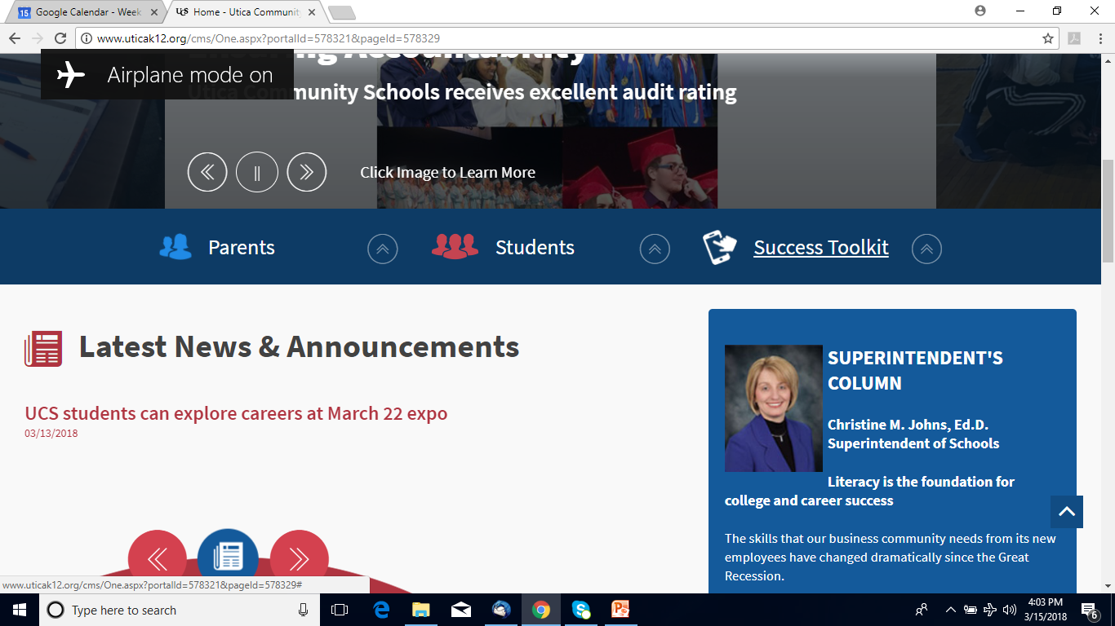
Overview of Resources
uticak12.org

Slide 6
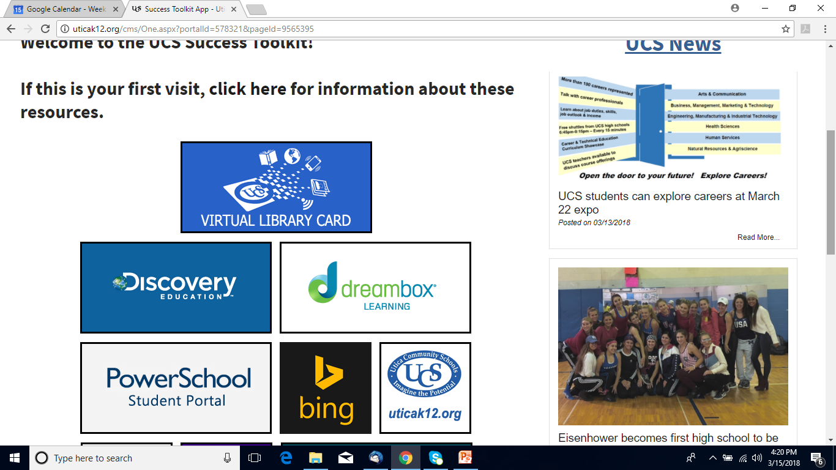
Overview of Resources

Slide 7
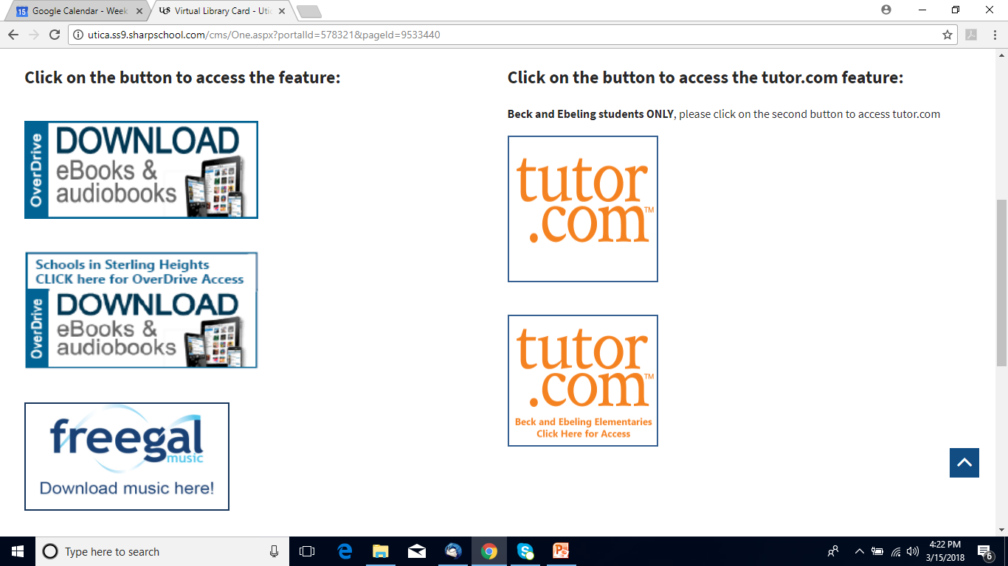
Overview of Resources

Slide 8
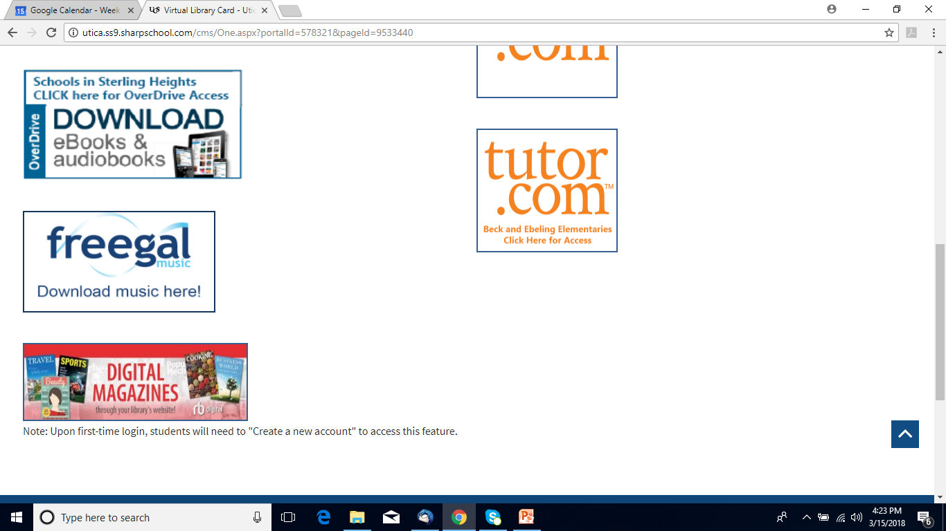
Overview of Resources

Slide 9
Overdrive
Check out books just like print books – place holds, check out for 21 days
Access to ebooks and eaudiobooks
Youth, Teen and Adult titles available
Libby app (Library is Midwest Collaborative)
https://mlc.overdrive.com/

Slide 10
tutor.com
Combines on-demand, real-time tutoring with several self-study tools to create a robust, personalized learning experience
Live Tutors available from (12pm-12am) noon – midnight everyday
The Princeton Review’s SAT/ACT Essentials Test Prep is included and available 24/7
Includes other services: Drop off review, practice quizzes, and study resources
www.tutor.com/suburban
https://www.dropbox.com/s/fpumfgtv3k2viss/Tutor.com%20Introduction%20-%20Long.mp4?dl=0

Slide 11
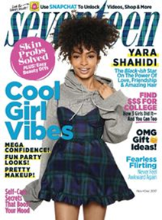
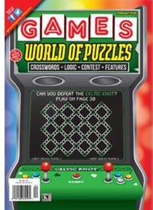
RBDigital
120+ magazines (have a few International Language titles)
Always available, no returns
Can receive email reminders when a new issue of a magazine you like is published
RBDigital app
http://sterlingheightsmi.rbdigital.com//

Slide 12
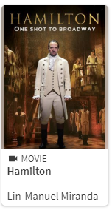
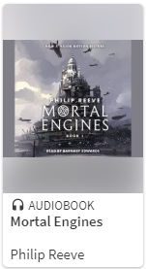
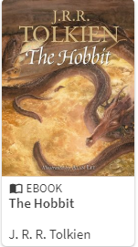
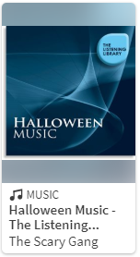
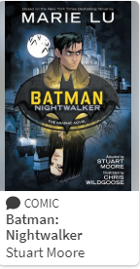
Hoopla
Over 700,000 ebooks, eaudiobooks, comics, music albums, movies, and tv shows
Always available, no returns
Check out 4 items each month
Hoopla app
https://hoopladigital.com/

Slide 13
Your Public Library
Sterling Heights Public Library
www.shpl.net
https://www.sterling-heights.net/678/Virtual-Library-Cards

Slide 14
Questions?
Thank You and We Look Forward to Working More With UCS

